Slide 1
CS 383 Team Lead 3
Quality Assurance and Patterns
Patterns
Tosin Bangudu, Kyle Hash, Liam Mathews

Slide 2
Isomorphic Design Demo

Slide 3
What Are Design Patterns
Design patterns are general solutions to problems in programming.
Great implementation flexibility.
Encapsulation of objects.
Can prevent future issues.
Can improve the readability of your code.
Three Primary Kinds:
Creational
Structural
Behavioral

Slide 4
2 Patterns Needed for Oral Exam

Slide 5
Creational
Abstract Factory
Builder
Factory Method
Prototype
Singleton
Focused primarily on the instantiation of a class and/or objects, according to your needs.

Slide 6
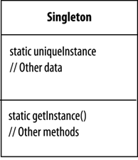
Singleton
Make sure a class has only one instance, and make it globally accessible.
Useful for when a feature is used by an application in only one way.
Makes connecting scripts in your project easier.
Allows for “lazy instantiation.”

Slide 7
EX: Singleton Design
Audio Manager
Score Manager
Health Manager

Slide 8
Singleton
Declare a private static instance of the class within itself.
Declare a public static instance of the initializer.
Static allows for the class instance to be called from other scripts without the need for a reference.
All variables and references within the Singleton class can now be accessed anywhere.
public class Singleton : MonoBehaviour
{
public static Singleton instance;
}

Slide 9
Singleton
Global access makes it easy to cause unwanted changes, be sure to protect and privatize variables and references.
Can make implementing changes more difficult as the project continues. Changes will need to be made in all associated scripts.
Be sure to know what you will need to do in advance!

Slide 10
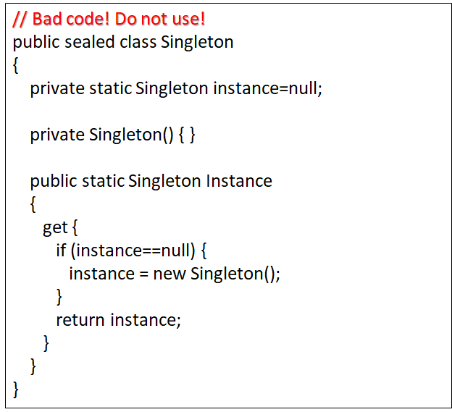
Singleton
Sealed keyword prevents creation of subclasses. (Not the bad part.)
Make sure that no more than one thread can be created by singleton class, this code can fail.
Unity is thread safe, so we will not worry about it for now.
Thread safety can be achieved in a variety of ways.

Slide 11
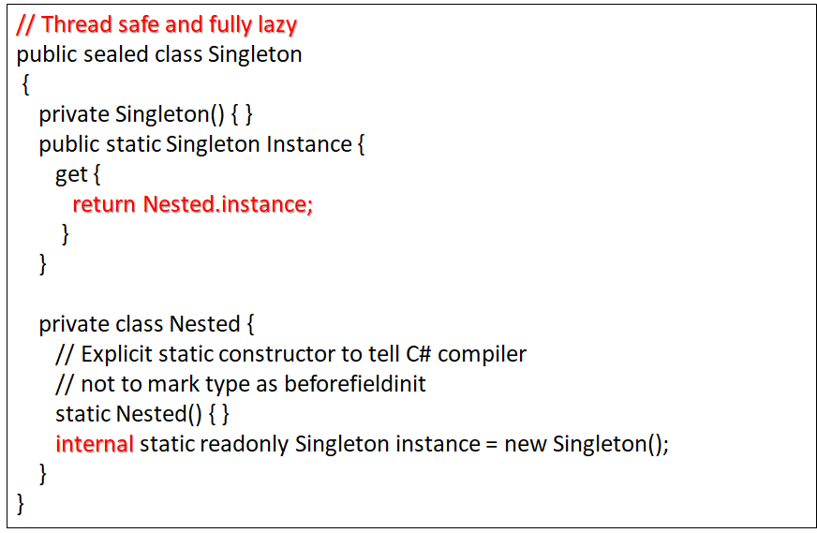
Singleton
Thread safe example.
Lazy instantiation, as it is started by the first reference to the contents of Nested().
Because the Nested class is marked private, the contents must contain the keyword internal to be visible to the rest of our Singleton class.

Slide 12
Singleton
Another way to make a singleton thread safe.
If you use this method, be prepared to explain why in the oral exam.
public class Singleton : MonoBehaviour
{
public static Singleton Instance { get; private set; }
}

Slide 13
Structural
Adapter
Bridge
Composite
Decorator
Facade
Flyweight
Proxy
Focused on the composition of classes and objects to form large structures.

Slide 14
Decorator
The Decorative Pattern serves as an alternative to inheritance.
Allows for additions to an entity to be added dynamically.
Traits in a “core” exist in all subclasses, allowing for recursive addition to an entity.

Slide 15
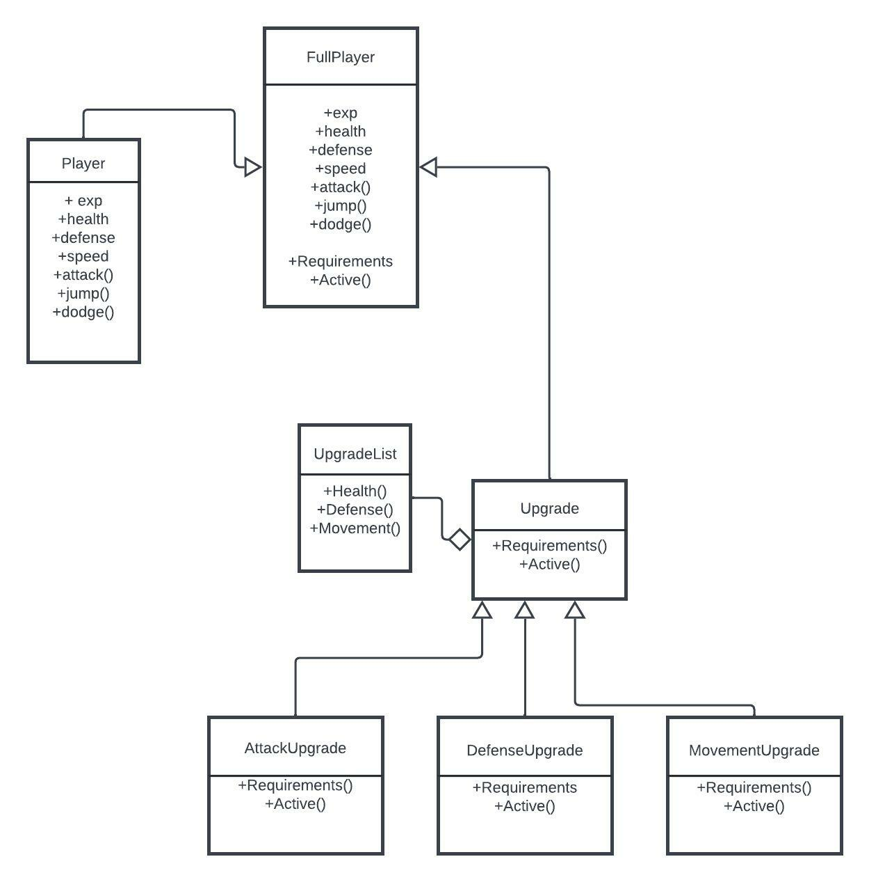
EX: Decorator Design
Feature: Skill Tree.
Decorative Pattern: Allows for dynamic changes to be made to an entity as the program runs.
.
Let’s say we want to upgrade our player’s attack value.

Slide 16
Decorator
For features such as a skill tree, inheritance is not viable, we want to make individual changes during runtime.
We can use recursion to create “wrapping paper” around a core class, and “wrap” that wrapping paper, and so on.

Slide 17
Decorator
Hit Points
Attack++
Attack++
Upgrade
Full Player
60
+5
+5
50

Slide 18
Decorator
Select a class to operate as the core.
Create subclasses which contain the elements of the core class.
Core class and preceding subclasses will receive changes made by decorators.

Slide 19
Behavioral
Chain of Responsibility
Command
Mediator
State
Memento
Strategy
Visitor
Focused primarily on the communication between classes.

Slide 20
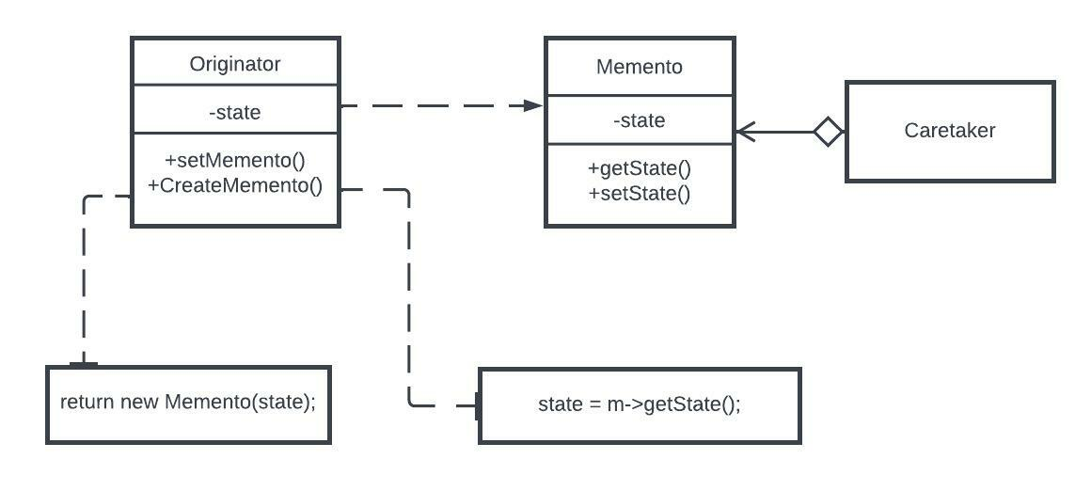
Memento
“Capture” the current state of an object so you can return to it later if necessary.
Does not violate encapsulation.
A “client” requests a memento from a source object, saves the internal state of the source object to an external file, that the client can later place back into the source object.

Slide 21
Memento
Originator: the source class that is able to save itself.
Caretaker: Decides reasoning and timing for the current state of the Originator to be saved.
Memento: handles the saving of the data in the Originator.

Slide 22
EX: Memento Design
Save state.
Checkpoints.
Undo Button.
Time Travel.

Slide 23
Memento
Decide which classes are Originator and Caretaker.
Create a Memento class to handle transaction of data into files.
Make sure the Originator class knows how to save itself.
Ensure that the Caretaker knows when to save the current state, and when to apply it back into the Originator.

Slide 24
Learn More
Design Patterns - Source Making
https://sourcemaking.com/design_patterns
Singletons in Unity (done right) - Game Dev Beginner
https://gamedevbeginner.com/singletons-in-unity-the-right-way/

Slide 25
Questions?

Slide 26
Team Deliverables
Thursday (10/6)
One Test Case to Demo /2
Initial Test Plan to Demo /10
Oral Exam
Full Test Plan /40
11/14-11/18
Patterns
Must implement 2 by Oral Exam /60

